Slide 1
Chapter 5 Descriptions and Prediction: Profiling and Predictive Modeling

Slide 2
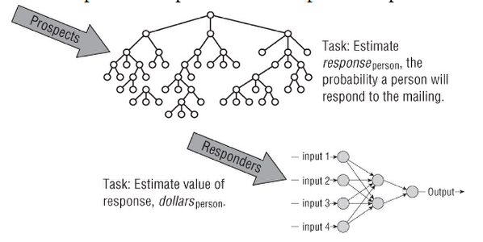
Directed Data Mining Models
Defining the Model Structure and Target
Requires understanding and defining the target variable the model is trying to estimate.
2 step model for estimating amounts

Slide 3
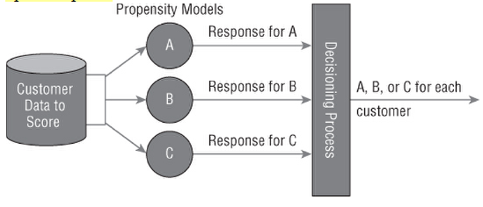
Cross-sell options
Chose the one with max profitability, revenue, or response propensity

Slide 4
Incremental response model
2 models
In Model 1 calculate the propensity to respond without any message.
In Model 2 calculate the propensity to respond to specific message.
Calculate the difference between the 2 response propensities and use the message with the biggest difference.

Slide 5
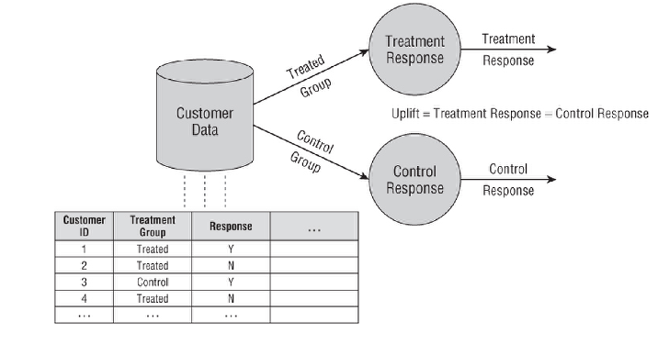
Incremental Response Modeling
Incremental response models estimate the increments in response based on the marketing message.

Slide 6
Why to do incremental response modeling?
Sure Things: who are going to respond to the offer, regardless of whether they get the message.
Persuadables: who are going to respond, but only because they get the offer.
Lost Causes: who are not going to respond, regardless of the offer.
Sleeping Dogs: who are going to do something nasty like quit, because the campaign reminds them that they do not really want to be customers.

Slide 7
Model Stability
Stability, the ability of a model to work not only on the model set but also on unseen data.
Stability has four big enemies:
Getting things wrong
Overfitting
Sample bias
Future may not be like the past

Slide 8
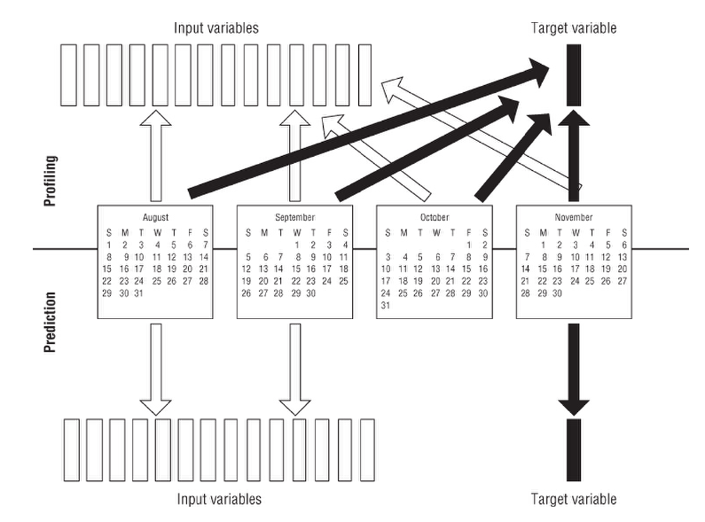
Time-Frames in the Model Set
Each variable in the model set has a time frame associated with it that describes the period that contributes to the variable.

Slide 9
Time-Frames in the Model Set
Prediction Models
The challenge with prediction is the amount of work needed to create the model set.
Profiling Models
Based on demographic variables, such as geographic location, gender, and age.
Limitation is the inability to distinguish cause and effect.

Slide 10
Directed Data Mining Methodology
1. Translate the business problem into a data mining problem.
2. Select appropriate data.
3. Get to know the data.
4. Create a model set.
5. Fix problems with the data.
6. Transform data to bring information to the surface.
7. Build models.
8. Assess models.
9. Deploy models.
10. Assess results.
11. Begin again.

Slide 11
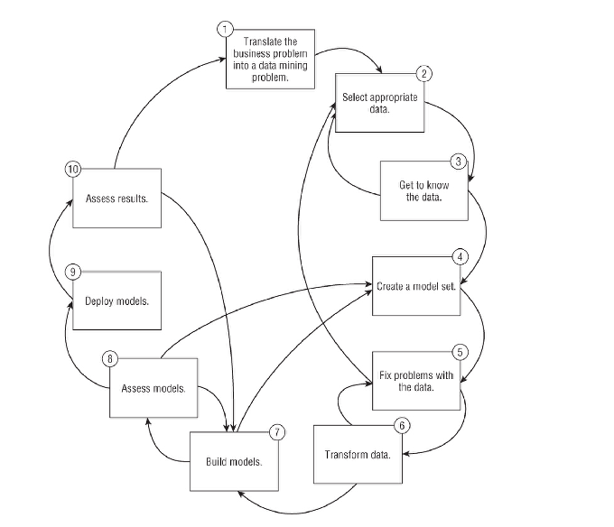

Slide 12
Data Mining Goals
Data mining goals for a particular project should not be stated in broad, general terms
Gaining insight into customer behavior
Discovering meaningful patterns in data
Learning something interesting
Challenge for such goals is:
they are hard to measure. Projects that are hard to measure are hard to put a value on.
Have specific goals that facilitate monitoring progress.
Identify customers who are unlikely to renew their subscription.
Design a calling plan that will reduce customer stop rates for home-based business customers.
Determine which Web transactions are possibly fraudulent.
List products whose sales are at risk.
Forecast the number of customers over the next three years,

Slide 13
Step 1: Translate the Business Problem into a Data Mining Problem
Misunderstanding the Business Problem: A Cautionary Tale
Someone with a high score on yogurt lover model is not good enough
How Will Results Be Used?
How Will Results Be Delivered?
The Role of Domain Experts and Information Technology

Slide 14
Step 2: Select Appropriate Data
After formulating the business problem, you should make a wish list of data that would be nice to have.
The data sources that are useful and available vary, of course, from problem to problem and industry to industry.

Slide 15
Step 2: Select Appropriate Data
What Data Is Available?
Datawarehouse, database stores at various departments, log files, etc.
How Much Data Is Enough?
Density: Should have enough data points for the entire range of target variable; stratified sampling may be the answer
How Much History Is Required?
Typically 2-3 years but ensuring that enough points are there for seasonlity
How Many Variables?
Often may need to reduce factors or combine variables
What Must the Data Contain?
Implicit in this description is the idea that data is available to describe what happened in the past.
Problems with no target variable are tough

Slide 16
Step 3: Get to Know the Data
Spending time exploring the data before rushing into building models
Examine Distributions
A good first step is to examine a histogram of each variable in the dataset and think about what it is telling you.
Data visualization tools can be very helpful during the initial exploration of a database.
Scatter plots, bar charts, geographic maps, and other visualization tools are immensely powerful for seeing what is in the data.

Slide 17
Step 3: Get to Know the Data
Compare Values with Descriptions
Look at the values of each variable and compare them with the description given for that variable in available documentation.
Validate Assumptions
Using simple cross-tabulation and visualization tools such as scatter plots, bar graphs, and maps, validate assumptions about the data.
Ask Lots of Questions
An important output of the data exploration process is a list of questions for the people who supplied the data.

Slide 18
Step 4: Create a Model Set
The model set contains all the data used in the modeling process.
Some of the data in the model set is used to find patterns.
Some of the data in the model set is used to verify that the model is stable.
Assess the model's performance.
Creating a model set requires assembling data from multiple sources to form customer signatures (discussed next) and then preparing the data for analysis.

Slide 19
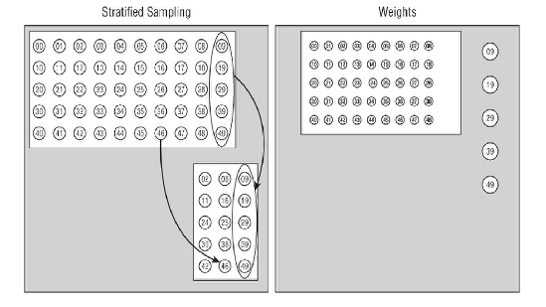
Step 4: Create a Model Set
Assembling Customer Signatures
When the data describes customers, the rows of the model set are often called customer signatures.
Creating a Balanced Sample
Stratified sampling
Add a weighting factor

Slide 20
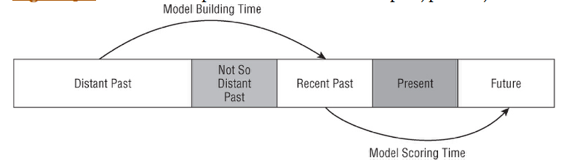
Step 4: Create a Model Set
Adding More Needles to the Haystack
Understand Outliers
Including Multiple Timeframes
Incorporating multiple time frames in the model set eliminates many of the effects of seasonality.
Creating a Model Set for Prediction

Slide 21
Step 4: Create a Model Set
Creating a Model Set for Profiling
the time frame for the target overlaps with the time frame for the inputs.
Partitioning the Model Set
Training set: used to build the initial model. validation set, test set,
Validation set: used to adjust the initial model to make it more general and less tied to the idiosyncrasies of the training set.
Test set: used to gauge the likely effectiveness of the model when applied to unseen data.

Slide 22
Step 5: Fix Problems with the Data
Categorical Variables with Too Many Values
Group the values so that many classes that all have approximately the same relationship to the target variable are grouped together.
Replace categories with interesting numeric values often produces good models.
Numeric Variables with Skewed Distributions and Outliers
Discard records that have outliers
Missing Values
Missing value imputation
If few then may be dropped

Slide 23
Step 5: Fix Problems with the Data
Values with Meanings That Change over Time
Require a well-designed data warehouse where such changes in meaning are recorded so a new variable can be defined that has a constant meaning over time.
Inconsistent Data Encoding
When information on the same topic is collected from multiple sources, the various sources often represent the same data different ways.

Slide 24
Step 6: Transform Data to Bring Information to the Surface
Adding derived fields to bring information to the surface
Removing outliers
Binning numeric variables
Grouping classes for categorical variables
Applying transformations such as logarithms
Turning counts into proportions

Slide 25
Step 7: Build Models
In directed data mining, the training set is used to generate an explanation of the dependent or target variable in terms of the independent or input variables.
Take the form of a neural network, a decision tree, a linkage graph, or some other representation of the relationship between the target and the other fields in the database.
Automated by modern data mining software.

Slide 26
Step 8: Assess Models
How accurate is the model?
How well does the model describe the observed data?
How much confidence can be placed in the model's predictions?
How comprehensible is the model?

Slide 27
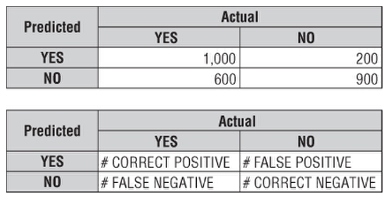
Step 8: Assess Models
Assessing Binary Response Models and Classifiers
Confusion matrix or
Correct classification matrix
Assessing Binary Response Models Using Lift

Slide 28
Step 8: Assess Models
Effect of Oversampling on Lift and Other Measures
Oversampling data to produce the model set typically improves lift

Slide 29
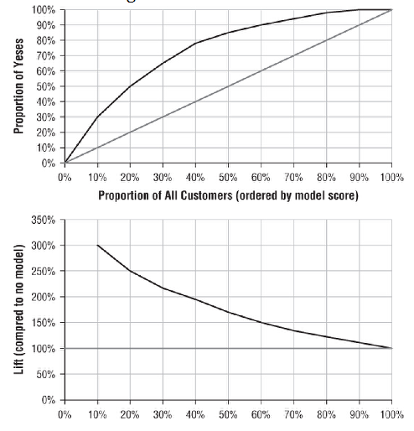
Step 8: Assess Models
Assessing Binary Response Model Scores Using Lift Charts

Slide 30
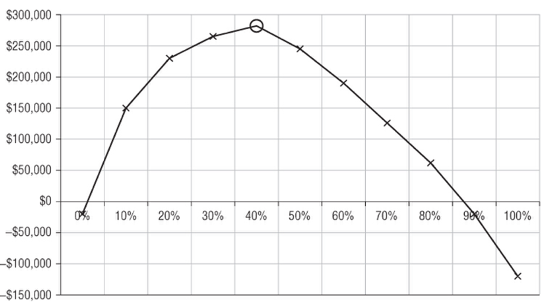
Step 8: Assess Models
Assessing Binary Response Model Scores Using Profitability Models
Is the model worth the time, effort, and money it costs to build it?

Slide 31
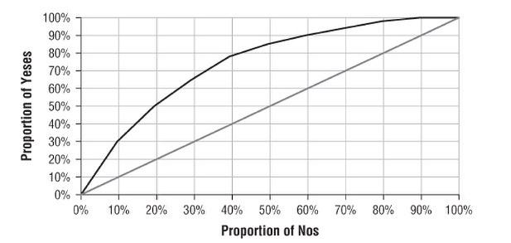
Step 8: Assess Models
Assessing Binary Response Models Using ROC Charts
An ROC chart looks very similar to a cumulative gains chart, but the horizontal axis is the proportion of false positives, rather than the proportion of the overall population.

Slide 32
Step 8: Assess Models
ROC Charts and Their Arcane Terminology
Receiver operating characteristics.
Plot the sensitivity of the model against specificity
Sensitivity is how well the models do at identifying the important outcomes.
Specificity is how well the models do at identifying other outcomes, so 1 – specificity is the false positive rate.
The particular measure for a given system was the area under the ROC curve, which is called discrimination.

Slide 33
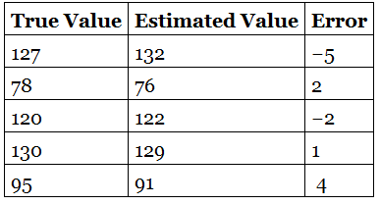
Step 8: Assess Models
Assessing Estimators
Variance:
The smaller the variance, the more accurate the estimate.
Drawback: not expressed in the same units as the estimates themselves.

Slide 34
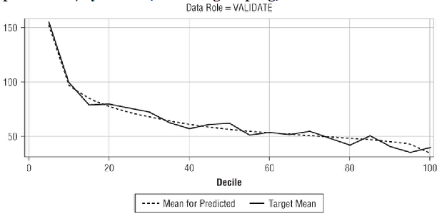
Step 8: Assess Models
Assessing Estimators Using Score Rankings
Score ranking charts is to divide the predicted target values into bins, typically deciles.
For each decile, the chart shows the average value of the predicted value and the average value of the actual value.

Slide 35
Step 9: Deploy Models
Deploying a model means moving it from the data mining environment to the scoring environment.
Tools produce scoring code in readily transferable formats, such as SAS code, SPSS code, SQL, Java, or C.
PMML (Predictive Modeling Markup Language) provides a mechanism for moving models and scoring code from one environment to another

Slide 36
Step 9: Deploy Models
Practical Issues in Deploying Models
Deploy the model code itself only solves half the problem because models often use input variables that are not in the original data.
The scoring process can be quite challenging, particularly when models are being scored in real time.
Optimizing Models for Deployment
Profitability calculations based on lift will help decide how to apply the results of the model.

Slide 37
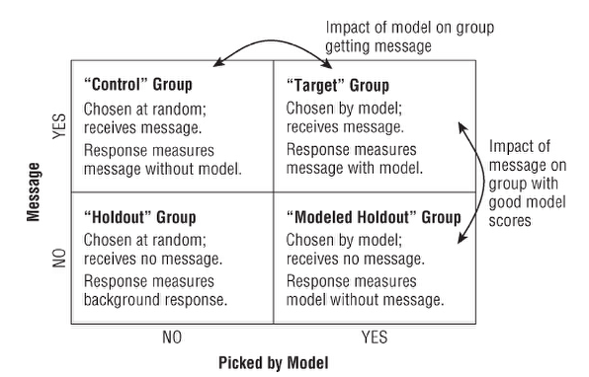
Step 10: Assess Results
Measuring the actual results — both financially and technically — is very important

Slide 38
Step 11: Begin Again
Every data mining project raises more questions than it answers.
The newly discovered relationships suggest new hypotheses to test and the data mining process begins all over again.

